Slide 1
Separate Phonemes /ɔr/ Merging?
A Real-time Study of the Cord-Card Merger
2nd Annual Interdisciplinary Conference at UGA
Athens, Georgia
October 9, 2015
Notes:
Are they separate phonemes OR merging phonemes?
These separate phonemes ARE merging?

Slide 2
Background
“[T]he validity of [apparent time studies] hinges crucially upon the hypothesis that the speech of, say, 40 year olds today directly reflects the speech of 20 year olds twenty years ago, and is thus comparable for diffusion research to the speech of 20 year olds today.”
“The hypothesis that apparent time can be equated to real time is by no means firmly supported, and the relationship between real and apparent time may indeed be more complex than a simple equation of the two.”
“[I]t is worth remembering that the hypothesis of apparent time remains to be tested.”
(Chambers & Trudgill 1980:165–6).

Slide 3
Hypothesis
Individuals undergo language change over the course of their lifetime.

Slide 4
Literature Review

Slide 5
Literature Review
Option 1: Track people down—it’s difficult, but possible
Change with the community (Sankoff & Blondeau 2007)
RP shift within individuals to match progressing change (Bauer 1985)
Speakers of Montreal French “continue to advance towards a newer phonology well into middle age”. (Yaeger-Dror 1994)
Option 2: Find previous recordings—good luck though
Queen of England’s Christmas broadcast messages (Harrington, Palethorpe, & Watson 2000)
Vowels changed the same direction as the Standard Southern British English

Slide 6
Cord-Card Merger
Middle English /or/ vs. /ɔr/ vs. /ar/.
/or/ | /ɔr/ | /ɑr/
oar/ore four hoarse mourning | or fore horse cord morning lord | are far card lard
hoarse-horse merger
cord-card merger
Notes:
Emphasize that /ɔr/ is the one I'm focusing on

Slide 7
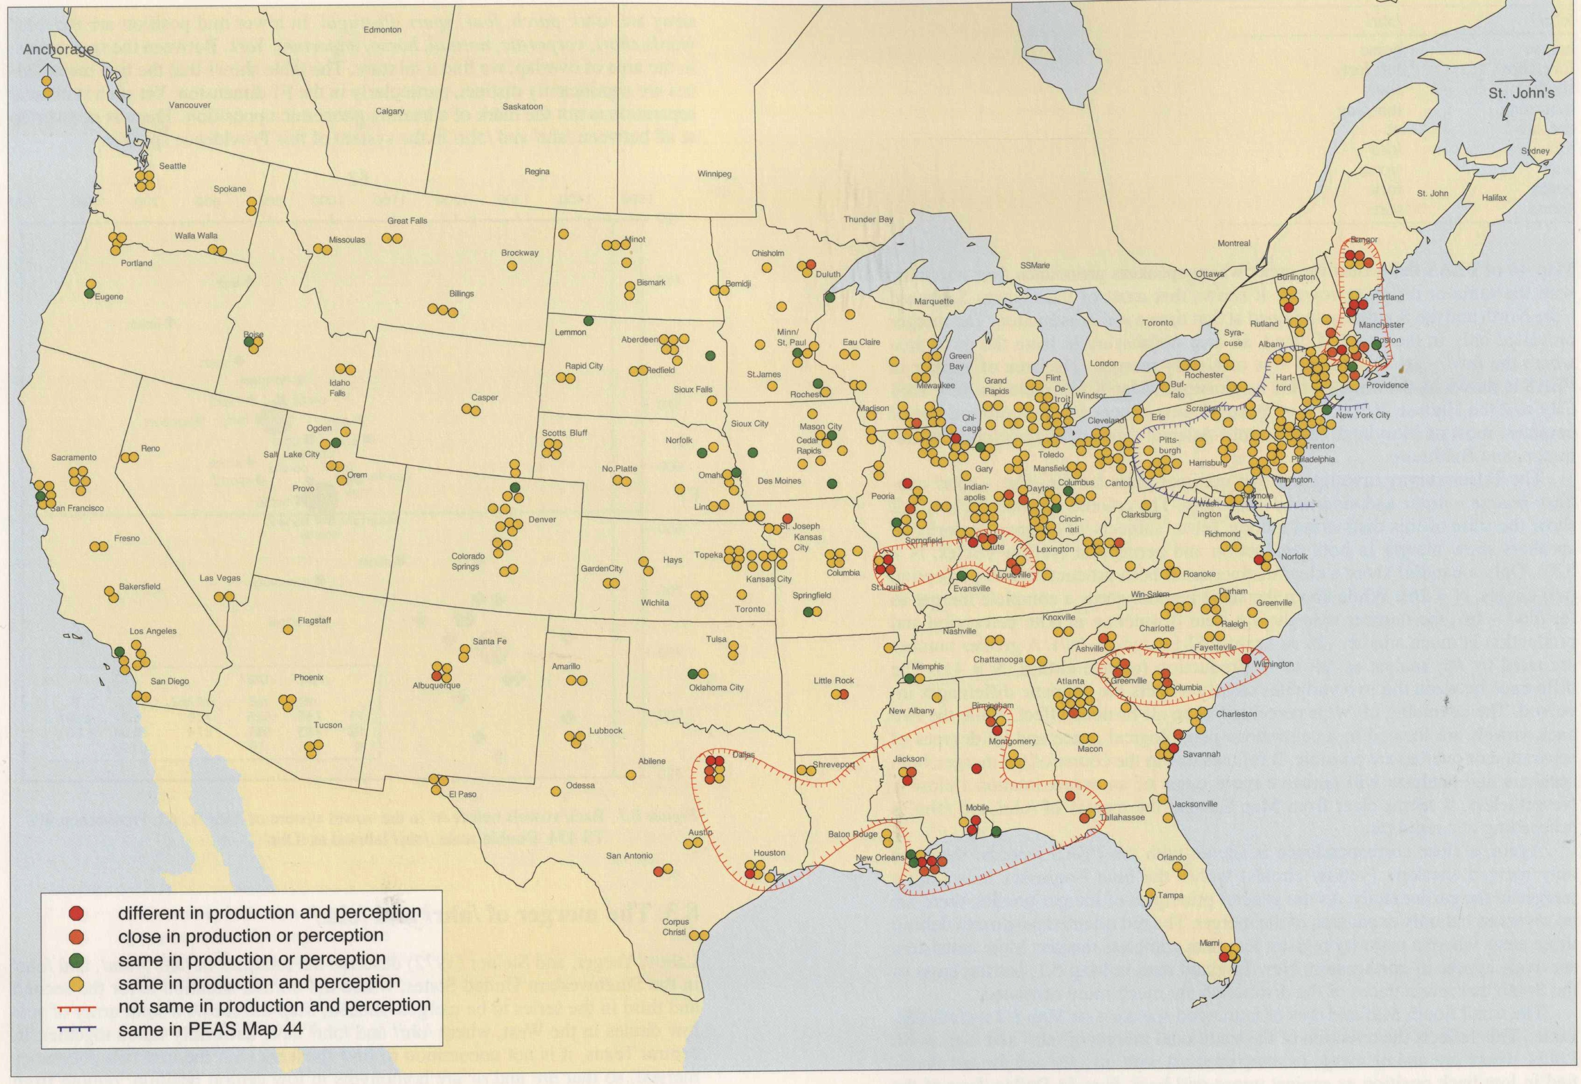
Labov, Ash, & Boberg (2006:52)

Slide 8
Cord-Card Merger in Utah
Not widespread among first-generation Utahns (1850s)
Rapidly merging late 19th century (Bowie 2003)
Reportedly completed by the 1930s (Helquist 1970)
Reversal started by the 1950s (Lillie 1998)
Essentially abandoned today (Bowie 2010)

Slide 9
Methodology

Slide 10
Corpus
LDS¹ General Conference talks
6 two-hour sessions, twice a year, for 180 years
Important to Mormons
Recorded since at least the 1930s
High quality audio and video
Talks from 1971–present are publicly available for download on lds.org
As a Linguistic Corpus
430 speakers, 3290 talks, at least 550 hours of speech
Ideal for real-time studies
43 speakers have at least a 20 year range
17 have a 30 year range
5 have a 40 year range
¹ The Church of Jesus Christ of Latter-day Saints (a.k.a. Mormon)

Slide 11
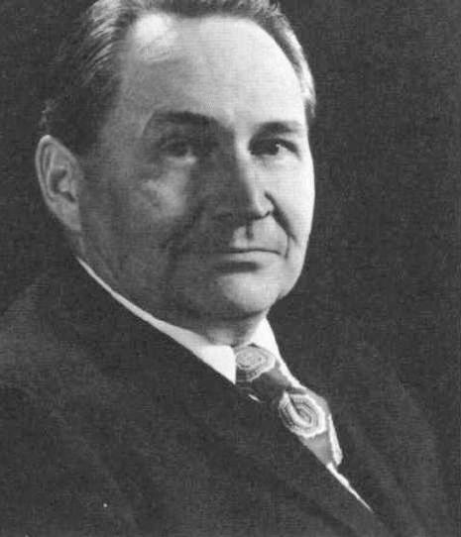
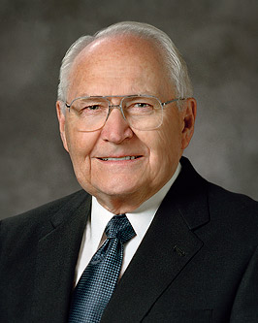

Speaker Selection
Tom Perry
Known informally among Mormons for his “distinctive voice”
a.k.a. the cord-card merger
Brief Bio
Born in 1922 in Logan, Utah
(Cord-card merger completed by the 30s)
Served in the Marines during WWII
B.S. in Finance at Utah State
Employment in New York, California, Washington, and Massachusetts
Began full-time service as a church leader in 1974 (age 52).
Passed away May 2015 (age 92)

Slide 12
Data Collection
Perry’s 84 conference talks
Two each year from 1972–2015
21 hours of speech
DARLA
DARLA (Reddy & Stanford 2015), using FAVE (Rosenfelder, Fruehwald, Evanini & Yuan 2011) and the VowelsR package (Kendall & Thomas 2010)
97,876 total vowels
Excluding diphthongs and unstressed syllables
Isolated potential cord-card words (n=1,311).
F1, F2, and F3 measurements at the midpoint of the vowel
Notes:
O or A + R

Slide 13
Analysis
Classified each potential word based on pronunciation in Walker’s Critical Pronouncing Dictionary (1807):
or
ɔr
ar
aboard, before, course, divorce, door, for, force, four, keyboard, more, porch, report, reward, roar, score, source, store, support, therefore, war, warning, warmth
according, born, corn, enormous, fork, forty, horse, important, lord, morning, nor, or, order, organize, quarters, record, shortage, storm, torch, uniform
apart, are, article, barn, car, charge, dark, depart, far, farm, garden, guard, harbor, heart, large, mark, marshmallow, part, patriarchal, regard, remarkable, start, target
Excluded
open syllables (authority, glory, historical, quorum, sorrow, story),
words not in the dictionary (Mormon, normal, R, York),
words with variable pronunciation (our, towards, your)

Slide 14
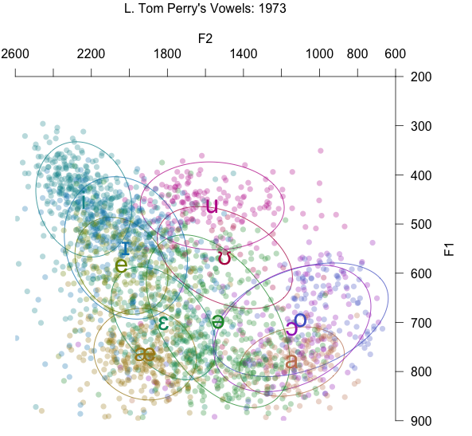
Analysis
R
phonR and ggplot2 packages to plot
manova()
JMP
More visuals
Excluded outliers
forced alignment isn’t perfect
Notes:
Outliers were defined as greater than 3 standard deviations from the mean F1, F2, or F3 for that vowel in that decade.

Slide 15
Results

Slide 16
MANOVA Tests
MANOVA: Multivariate Analysis of Variance
multiple continuous dependent variables as predicted by categorical independent variables
In this case: F1, F2, and F3, as predicted by vowel class
Test 1: /ɔr/ = /ar/ in 1970s
Pillai’s score: 0.17503, df = 3, p < 0.0001
Conclusion: They were different
Test 2: /ɔr/ = /or/ in 2010s
Pillai’s score: 0.083903, df = 3, p = 0.001
Conclusion: They were different still.
p-values can be misleading with large datasets

Slide 17
Visual Tests
Bubble Plot in JMP
Vowels raise over time
Probably not sociolinguistically significant because the vocal tract lengthens with age, causing vowels to raise over time (Xue & Hao 2003)
Distribution of F1 and F2 in R

Slide 18
1970s

Slide 19
1980s

Slide 20
1990s

Slide 21
2000s

Slide 22
2010s

Slide 23
Visual Tests
Bubble Plot in JMP
Vowels raise over time
Probably not sociolinguistically significant because the vocal tract lengthens with age, causing vowels to raise over time (Xue & Hao 2003)
Distribution of F1 and F2 in R
All three overlap somewhat
/ɔr/ closer to/ar/ in 1970s
/ɔr/ more like /or/ in 2010s.
3D Scatterplot in JMP
closer to cord-card merger in 1970s
closer to horse-hoarse merger in 2010s

Slide 24
Conclusion

Slide 25
Conclusion
1970s: cord-card merger
2010s: hoarse-horse merger
Not a complete phonemic shift, but still a significant change.
More like modern Utah and less old-fashioned.
Just like the Queen of England (Harrington, Palethorpe & Watson 2000)
Change is faster than apparent-time would lead us to believe. (Labov 1994)

Slide 26
References
Bailey, Guy, Tom Wikle, Jan Tillery & Lori Sand. 1991. The apparent time construct. Language Variation and Change 3(03).
Bauer, L. 1985. Tracing Phonetic change in the received pronunciation of British English. Journal of Phonetics 13. 61–81.
Bowie, David. 2003. Early development of the card-cord merger in Utah. American Speech 78(1). 31–51.
Bowie, David. 2008. Acoustic characteristics of Utah’s CARD-CORD merger. American Speech 83(1). 35–61.
Bowie, David. 2010. The Ageing Voice: Changing Identity Over Time. Language and Identities, 55–65. Edinburgh: Edinburgh University Press.
Chambers, John Kenneth & Peter Trudgill. 1998. Dialectology. Cambridge University Press.
Harrington, Jonathan, Sallyanne Palethorpe & Catherine Watson. 2000. Monophthongal vowel changes in Received Pronunciation: An acoustic analysis of the Queen’s Christmas broadcasts. Journal of the International Phonetic Association 30(1-2). 63–78. (20 April, 2015).
Helquist, Val J. 1970. A study of one phonological variable in urban and rural Utah.
Kendall, Tyler and Erik R. Thomas. 2010. Vowels: vowel manipulation, normalization, and plotting in R. R package. cran.r-project.org/web/packages/vowels/index.html.
Labov, William. 1994. Principles of linguistic change. Vol. 1: Internal features. Oxford: Blackwell.
Lillie, Diane DeFord. 1998. The Utah dialect survey. Brigham Young University. Department of English.
R Development Core Team (2004). R: A language and environment for statistical computing. R Foundation for Statistical Computing, Vienna, Austria. http://www.R-project.org.
Reddy, Sravana and James Stanford. 2015. Toward completely automated vowel extraction: Introducing DARLA. Manuscript. Under review at Linguistics Vanguard.
Rosenfelder, Ingrid; Fruehwald, Joe; Evanini, Keelan and Jiahong Yuan. 2011. FAVE (Forced Alignment and Vowel Extraction) Program Suite. http://fave.ling.upenn.edu.
Sankoff, Gillian & Hélène Blondeau. 2007. Language change across the lifespan: ʀ in Montreal French. Language. 560–588.
Xue, Steve An & Grace Jianping Hao. 2003. Changes in the human vocal tract due to aging and the acoustic correlates of speech production: a pilot study. Journal of Speech, Language & Hearing Research 46(3). 689–701.
Yaeger-Dror, Malcah. 1994. Phonetic evidence for sound change in Quebec French. Phonological Structure and Phonetic Form. 267–293.

